Slide 1
BTP Project I Presentation
(CS47005)

Slide 2
Demo and Heuristics on Binary Network Public Goods Games
Guide: Professor Palash Dey
Presented by:
Ashish Rekhani (20CS10010)
Semester: Autumn 2023-24
Date: 7th November 2023

Slide 3
Motivation

Slide 4
Understanding BNPG Games
Network of Nodes (similar to human networks. Eg: Facebook friends)
Each node has binary choices: INVEST(1) into a shared project or ABSTAIN(0)
Each choice influenced by the node trying to maximise its incentive.
Common examples: Reporting a crime, Wearing a mask, Adopt sustainable practices for environment

Slide 5
Understanding BNPG Games
Determining an optimal strategy difficult because difficult to quantify the optimality of the strategy. So we introduce the concept of Pure Strategy Nash Equilibrium (PSNE).
PSNE is a set of player strategy combinations where no player has an incentive to change their strategy.

Slide 6
Understanding BNPG Games
But what if no PSNE exists for a given network!
Determining the existence of PSNE itself a big problem in this domain
Known to be a NP-complete problem
Introducing Altruism: The player look for collective good and not just personal gain

Slide 7
Understanding Altruistic Network Modification
This is a special case where we try to modify the altruistic network so that a given strategy profile becomes a PSNE
We can add or remove edges in the altruistic network but these come at a cost
We aim to keep the total cost to be within a given budget.
This problem computationally more difficult than finding a PSNE

Slide 8
Problem Statement

Slide 9
Objectives
Design small and medium sized random synthetic networks for testing and experiments
Implement an algorithm which naively determines the existence of PSNE in a given network
Develop heuristics and experimentally verify the results obtained comparing them with the results from the previous program

Slide 10

Explaining common notations
U_v - Utility function for node v
C_v - Cost function
g_v - positive externality of investment choices by v’s neighbours
a - altruism coefficient
n_v - number of neighbours of node v investing

Slide 11
Current Progress

Slide 12
Progress
We have used SNAP library for C++ to create the networks
The generator code for the same is ready and can be used to create small as well as medium sized graphs.
For large-sized human networks, we can use the readily available networks as part of SNAP

Slide 13
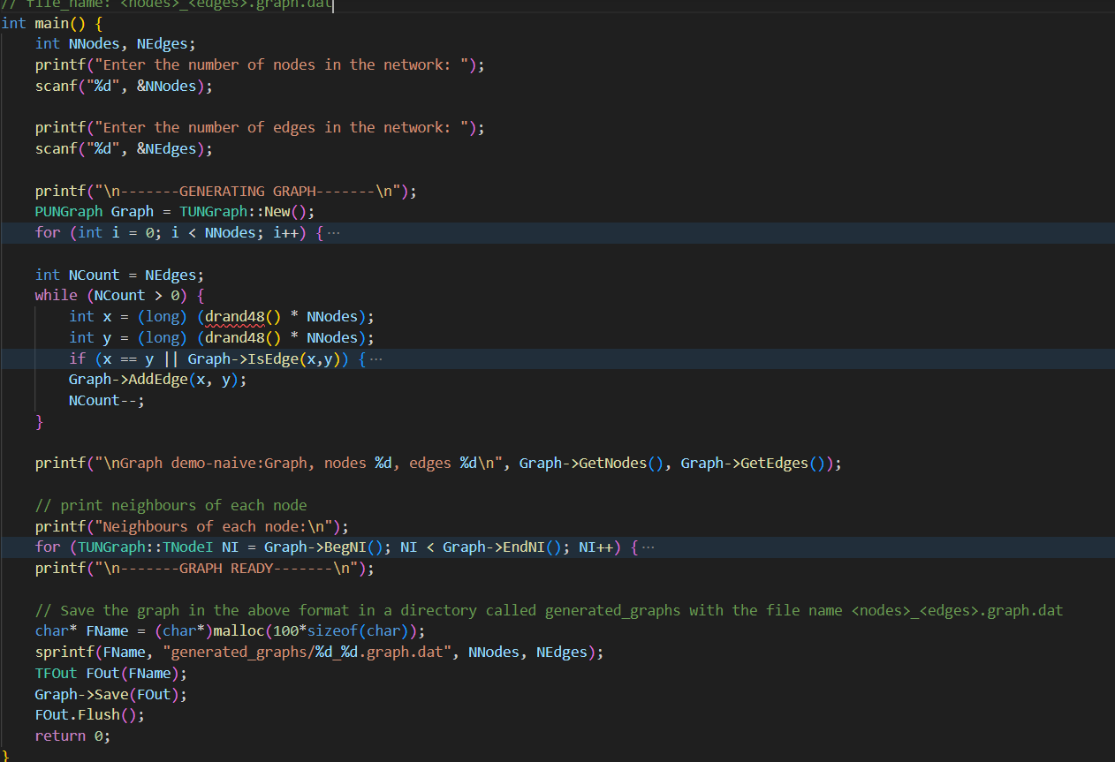
Progress

Slide 14
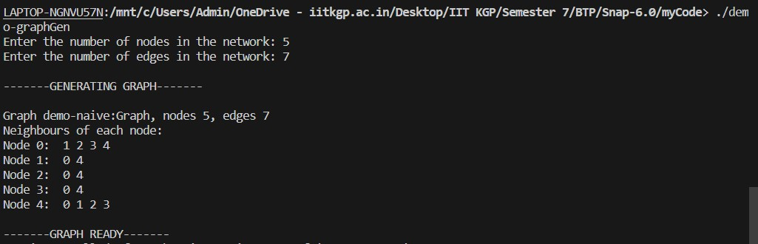
A small sample graph created by the network.

Slide 15
Progress
Naive-algorithm has been implemented. This can now be used to run on the dataset of networks which can be created from the network generator.

Slide 16
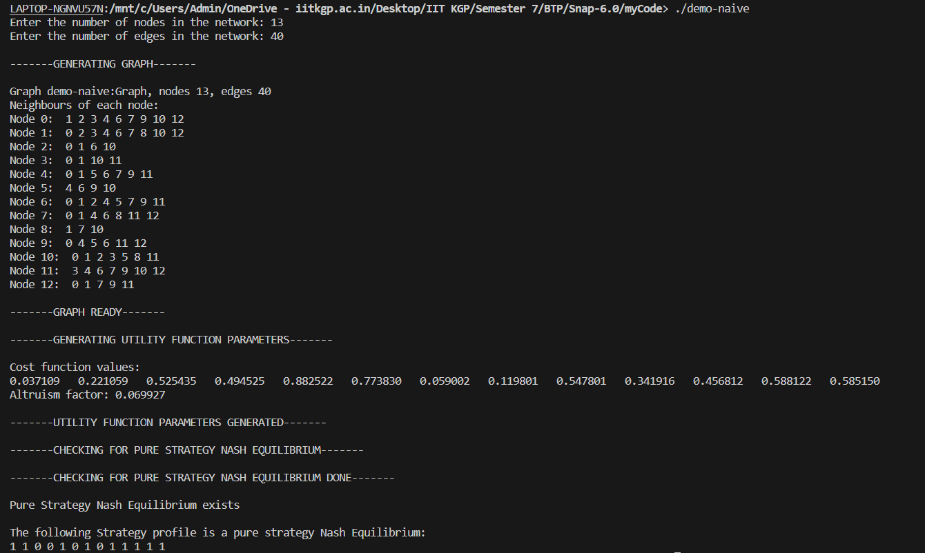
Demo Result

Slide 17
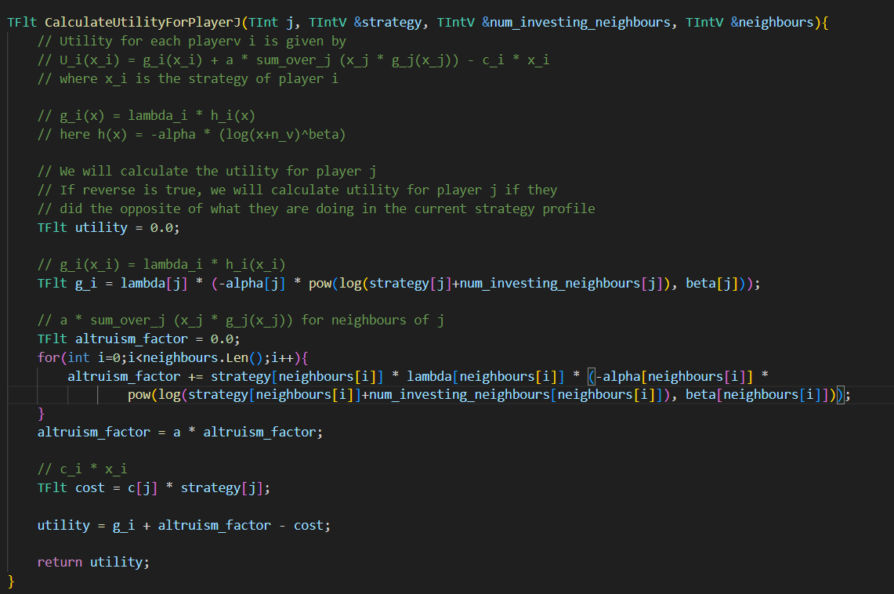
Objectives

Slide 18
Future Work

Slide 19
Future Work
Developing Heuristics for the algorithms, and implementing them to test experimentally.
Test the algorithm on large-scale synthetic as well as human networks
Improving algorithm in terms of storage taken as well as use programming practices to further reduce computational time

Slide 20
Thank you

